Slide 1
Welcome to all
for the Advertising Online lecture
By
Dr. Dhiraj Ovhal
HOD of Commerce

Slide 2
Q.4 Classification/Types of Advertising
Area | Audience | Media | Function | Ad. Stages
Local | Consumer | Press/Print | Direct & Indirect action | Pioneering stage
Regional | Industrial | Broadcasting | Primary & Selective | Competitive stage
National | Trade | Outdoor | Product & Institutional | Retentive stage
International | Professional | Other

Slide 3
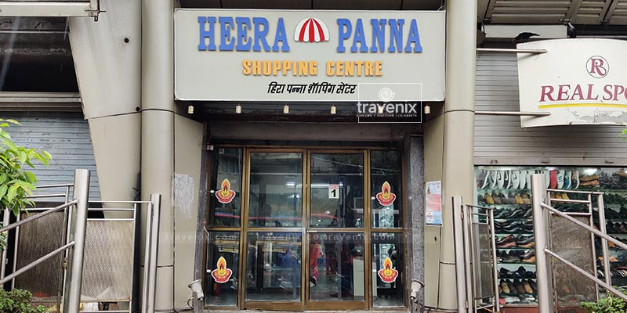
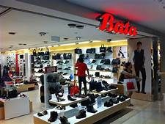
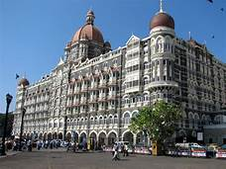
1. Local Advertising:-
Local adverting:-
(Mumbai)
Regional Advertising :-
(Maharashtra)
National Advertising:-
(India)
International Advertising :-
(World )

Slide 4
1. Local Advertising:-
Local adverting:- Retailer Advertising ---response expected from customer "Buy at my store " example- Heera -Panna Showroom- Media- Local
Regional Advertising :- It is applicable in any particular region and State like Chate Coaching classes is famous in Maharashtra state only.- Regional Media
National Advertising:- Response expected from customer "Buy at my brand only " example- Colgate, Bata.- National Media
International Advertising :- It is covered international market such as Wipro, Nike, Airlines, Hotels, etc.– International Media

Slide 5
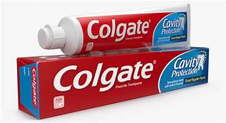
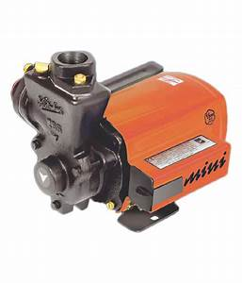
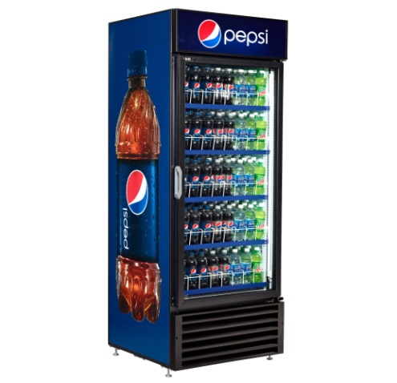
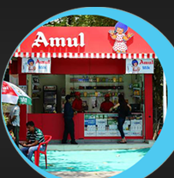
2. Regional Advertising:-
Consumer adverting:-
Industrial Advertising
Trade advertising:-
Professional advertising:-

Slide 6
2. Audience Advertising:-
Consumer adverting:- Applicable to common people .
It is selling FMCG and Consumer durable products like Mobile, Soap, Colgate,etc,
Industrial Advertising :- It is applicable to industrial production . It is supply for Raw materials, WIP, Finished goods such as Industrial products, Kirloskar Pump & Transformer.
Trade advertising:- Response expected from dealers " To stock and Promote my Stock only " example- Refrigerator provided by Pepsi to local shop.
Professional advertising:- Response expected from professional people " To recommend or prescribe our product only example- Free medicines are provided to doctor

Slide 7
3. Media Advertising:-
Media means channel of communication through which ad messages are transmitted or transferred to the audience .
Press/Print:- NEWSPAPER, Magazine,
Broadcasting/Telecasting:- T.V. and Radio
Outdoor: - Poster, banner, Hoarding, Billboard, Transit advertising, Window shopping
Other media :- Internet, Whatsapp, Facebook, Calendar, Diaries

Slide 8
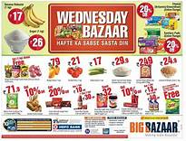
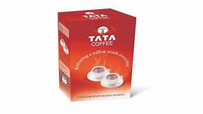
4. Function Advertising:-
Direct & Indirect action:-.
(XYZ Class of TYBCom)
Primary & Selective: -
Product & Institutional: -

Slide 11
4. Function Advertising:-
Direct & Indirect action:- direct means immediate action or response on particular date like Big bazaar 15th august discount. Indirect action means when demand arise in future
Primary & Selective: - primary to generate demand like coffee board of India gives ad to consume more coffee. Selective ---- to drink only Tata Coffee.
Product & Institutional: - Product means :- Samsung Mobile, Colgate, Soap,etc.
Institutional means Corporate advertising like Tata, Sahara India

Slide 12
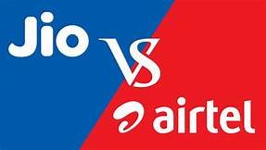
5. Advertising. Stages :-
Pioneering advertising:-
Competitive Advertsing:-
Retentive Advertsing : - It is also Reminder Advertising

Slide 13
5. Advertising. Stages :-
Pioneering advertising:- It is also called as Introductionary Advertising. It is done at the time product launch in the market.
Competitive Advertsing:- It is done to compete and maintain the product share in the market. Such as Jio Vs Airtel. Colgate Vs Pepsodent
Retentive Advertsing : - It is also Reminder Advertising to remind the customers about products available in the market

Slide 14
Q.4 Classification/Types of Advertising
Area | Audience | Media | Function | Ad. Stages
Local | Consumer | Press/Print | Direct & Indirect action | Pioneering stage
Regional | Industrial | Broadcasting | Primary & Selective | Competitive stage
National | Trade | Outdoor | Product & Institutional | Retentive stage
International | Professional | Other

Slide 15
Thank You

Slide 16
Attendance Link
https://forms.gle/U4Da9ykpniL3tpCdA
(Mention date at last point)

Slide 17
